Slide 1


Support Level
Support Details
Cost
Tier 1
Provide investigators with database resources for self-development
Brief consult on design, aims, and analysis
First Hour Free
$75 Each Additional Hour
Minimal
Tier 2
Support for database development, management, and technical assistance
Biostatistics GRA support for design, aims, and analysis
Faculty supervision for the life of the project
15% FTE: Database Manager
15% FTE: Biostatistics GRA
5% FTE: Faculty Supervision
Moderate
Tier 3
15% FTE: Database Manager
20% FTE: Faculty Biostatistics Support
Advanced
All Tier 2 services
Biostatistics faculty support for design, aims, and analytics for the life of the project

Slide 2
Supporting and enhancing study design, data capture, and analytics for Pediatrics research.
To Get Started
CLICK HERE!
Our Three-Tiered Service-Delivery Model
Support Level
Support Details
Cost
Tier 1
First Hour Free
$75 Each Additional Hour
Minimal
Provide investigators with database resources for self-development
Brief consult on design, aims, and analysis
Tier 2
Support for database development, management, and technical assistance
Biostatistics GRA support for design, aims, and analysis
Faculty supervision for the life of the project
15% FTE: Database Manager
15% FTE: Biostatistics GRA
5% FTE: Faculty Supervision
Moderate
Tier 3
All Tier 2 services
Biostatistics faculty support for design, aims, and analytics for the life of the project
15% FTE: Database Manager
20% FTE: Faculty Biostatistics Support
Advanced

Slide 3
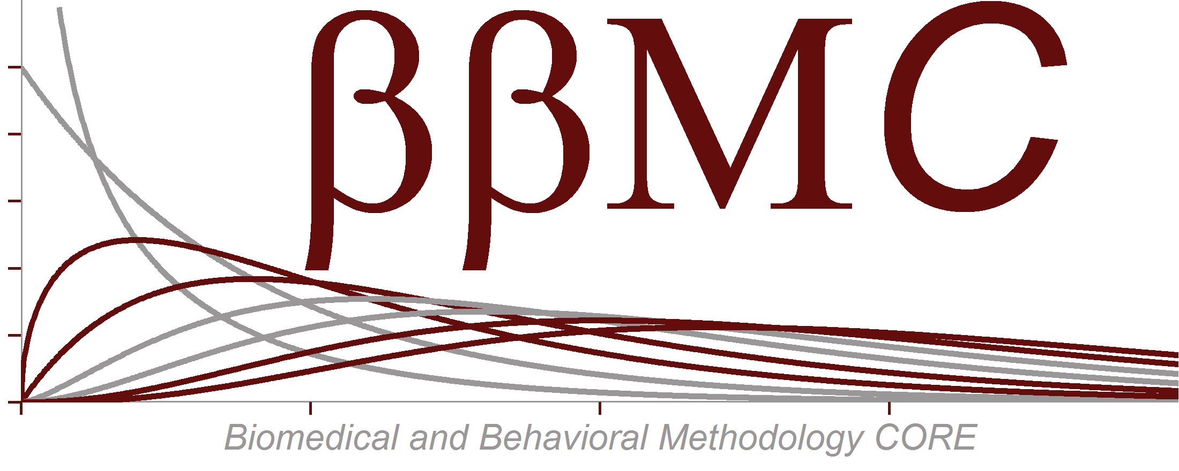
Supporting and enhancing study design, data capture, and analytics for Pediatrics research.
To Get Started
CLICK HERE!
Our Three-Tiered Service-Delivery Model
Support Level
Support Details
Cost
Tier 1
First Hour Free
$75 Each Additional Hour
Minimal
Provide investigators with database resources for self-development
Brief consult on design, aims, and analysis
Tier 2
Support for database development, management, and technical assistance
Biostatistics GRA support for design, aims, and analysis
Faculty supervision for the life of the project
15% FTE: Database Manager
15% FTE: Biostatistics GRA
5% FTE: Faculty Supervision
Moderate
Tier 3
All Tier 2 services
Biostatistics faculty support for design, aims, and analytics for the life of the project
15% FTE: Database Manager
20% FTE: Faculty Biostatistics Support
Advanced

